Slide 1
PULMONARY REVIEW

Slide 2
PULMONARY REVIEW
Air, Lungs, Blood
  Air-78% N₂, 20.9% O₂, 0.035% CO₂
  Lungs-Bronchoalveolar
  Blood
    O₂ carried on hemoglobin or as O₂
    CO₂ carried as CO₂, HCO₋₃, H₂CO₃, Hemoglobin
Fick equation?
  Diffusion=AD(P₁-P₂)/T
    A is cross sectional area, D is diffusivity (sol/√MW), P is partial pressure, and T is thickness of membrane or diffusing distance

Slide 3
GAS/BLOOD FLOW TO LUNGS=V/Q
Cardiac output (Q) is 5 L/min
Ventilation (V)
  Frequency (breaths/min)-8-16 b/min
  Single breath volume (Tidal Volume)-400-800 ml/breath
  Total or pulmonary ventilation=(f)(V_{T}) (use 12, 500)
  Alveolar ventilation=(f)(V_{T}-V_{D}) (V_{D} is 2 ml/kg body weight)

Slide 4
RESPIRATORY PHYSIOLOGY
I. Overview
  Must have oxygen delivery (see cardiovascular material) and carbon dioxide removal
II. Functional Anatomy
  Conducting Airways
    Pathology Note-Anatomic Dead Space (2 ml/kg body weight)
  Respiratory Airways

Slide 5
A. CONDUCTING AIRWAYS
Nose, mouth, pharynx, larynx, trachea, bronchi, and conducting bronchioles
  Large size, airway resistance is greater….why….arranged in series
    1. Bronchi-
      Large (> 1 mm in diameter), with supportive cartilage rings (w/out would collapse)
      Fewer cartilage rings as they progressively branch
      Those branches w/out cartilage and < 1 mm in diameter are bronchioles
      Note that bronchi are not imbedded in the lung parenchyma, so they can dilate/constrict independent of the lung
    2. Mucociliary tree- cells with cilia to move trapped particles
      Bronchial epithelium with pseudostratified columnar cells, many are ciliated, along with mucus-secreting goblet cells

Slide 6
A. CONDUCTING AIRWAYS (Cont..)
      Mucus traps inhaled particles, before the alveoli, mucus transported by beating cilia proximally, swallowed or expectorated……mucociliary escalator or tree
      Clinical note:
        Primary ciliary dyskinesia-autosomal recessive disorder with cilia unable to beat normally…chronic cough and recurrent infection
        Secondary ciliary dyskinesia caused by cigarette smoke
    3. Conducting (terminal) bronchioles
      Small airways imbedded in lung parenchyma (no cartilage)
      Change with lung inflation
      Clinical note: Asthma, smooth muscles of large airways become hypersentive to stimuli, get bronchoconstriction. Produces turbulent airflow (on exam…wheezing)

Slide 7
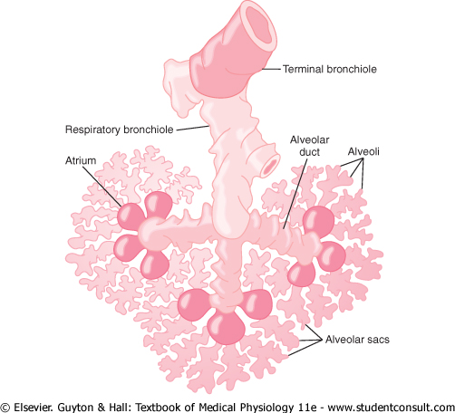
B. RESPIRATORY AIRWAYS
Respiratory bronchioles, alveolar ducts, and alveoli
Small size-less resistance (parallel)
No cartilage, imbedded
Diameter determined by lung volume

Slide 8
C. PULMONARY MEMBRANE:
THE AIR-BLOOD BARRIER
Multiple layers
  Surfactant-containing fluid-Type II epithelial cells
  Alveolar epithelium composed of pneumocytes (I and II)
  Epithelial and capillary basement membranes (with interstitial space between)
  Capillary endothelium
  Pathology note:
    Most cells are Type I pneumocytes (gas exchange), Type II cells produce surfactant (more later on this). Damage lung tissue Type II can differentiate into Type I.

Slide 9
PULMONARY BLOOD FLOW
Lungs are well perfused, but perfusion varies with lung region
Differential perfusion is only significant in the upright position, when gravity has an effect
So, the lungs are said to have zonal distribution of flow

Slide 10
CLINICAL NOTE
Oxygen diffusion is impaired by any process that decreases the oxygen pressure gradient (e.g., high altitude), decreases the surface area (e.g., emphysema), or increases the diffusion distance (e.g., pulmonary fibrosis)

Slide 11
CLINICAL NOTE
Pathophysiological mechanisms that reduce diffusing capacity
  (1) increased thickness of the membrane in restrictive diseases (e.g., pulmonary fibrosis, silicosis)
  (2) collapse of alveoli and lung segments (atelectasis) which decreases surface area (e.g., bed rest after surgery)
  (3) Poor lung compliance, reducing ventilation (e.g., silicosis)
  (4) destruction of alveolar units, decreases surface area (e.g., emphysema)

Slide 12
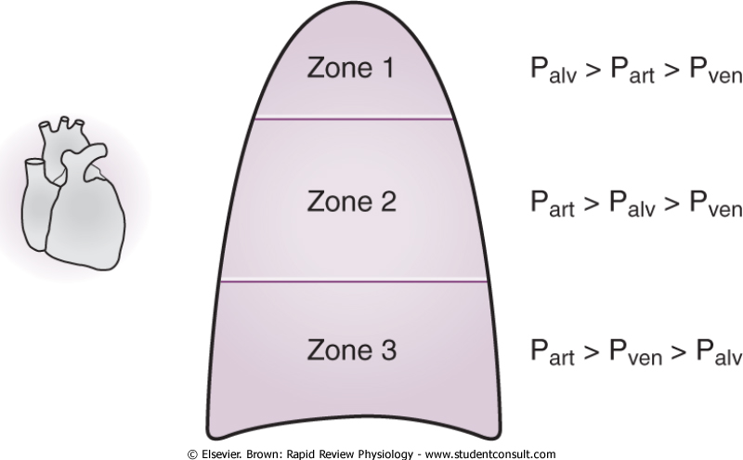
ZONES OF BLOOD FLOW
No flow during diastole
Continuous blood flow
Zone 1 conditions occur in severe hemorrhage and during positive pressure ventilation

Slide 13
CLINICAL NOTE
Zone 3 conditions are exploited during cardiac monitoring
Swan-Ganz or pulmonary artery catheter is inserted through central vein, advanced to the pulmonary artery, inflate a balloon at the tip wedges it into a branch of the pulmonary artery (recall this blood is heading to the left atrium and left ventricle).
When the balloon is inflated, the pulmonary artery occlusion pressure or “wedge pressure” is obtained. Indirect measure of left-ventricular end-diastolic pressure (LVEDP). LVEDP indirect measure of left-ventricular volume (thus cardiac performance and volume status)

Slide 14
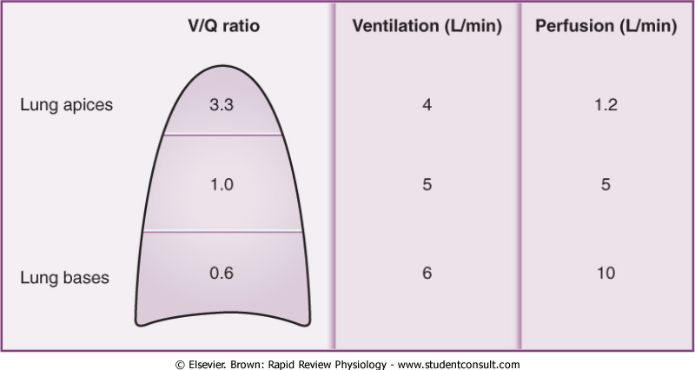
VENTILATION-PERFUSION (V/Q) MATCHING

Slide 15
1. MECHANISMS OF MAINTAINING V/Q MATCHING
Optimal matching achieved by hypoxia-induced vasoconstriction and by changes in response to exercise
Hypoxia-induced vasoconstriction
  In most capillary beds, hypoxia stimulates vasodilation, in the pulmonary system, stimulates vasoconstriction of pulmonary arterioles, prevents perfusion of under-ventilated lung regions
  Mechanism best illustrated in fetal lungs

Slide 16
PATHOLOGY NOTE
At high altitude, with low Po₂ , pulmonary vasoconstriction becomes harmful, causing a global hypoxia-induced vasoconstriction
This inhibits gas exchange and increases pulmonary vascular resistance, contributing to right-sided heart failure (cor pulmonale)

Slide 17
B. CHANGES WITH EXERCISE
At rest, 1/3 of pulmonary capillaries are open; opening of others (particularly in zone 1) occurs in exercise due to:
  Β₂-Mediated vasodilation (minor effect)
  Increased pulmonary artery blood pressure (major effect)
During exercise, V and Q become more efficient because:
  (1) increased CO means more blood to underperfused lung apices
  (2) ventilation is increased in underventilated lung bases
Note time in the capillary is very important

Slide 18
C. SHUNTS
A shunt is defined as the blood that bypasses the lung, or that does not participate in gas exchange
(1) physiologic shunt
  Perfusion of non-ventilated lung portions
  Bronchial arteries are part of the shunt, blood going to bronchial tissue does not travel to alveoli for gas exchange
(2) anatomic shunt
  Diversion of venous blood from the lungs
  Fetal blood flow is the example, CO is shunted from the pulmonary artery to the aorta through the ductus arteriosus, or passes through the foramen ovale (between right and left atria)
(3) Cardiac defects causing shunting
  Ventricular septal defects can lead to R to L shunting, always results in hypoxia and oxygen administration does nothing. L to R shunts do not cause hypoxia but do cause bilateral ventricular hypertrophy. Patent ductus arteriosus

Slide 19
PULMONARY FUNCTION TESTS
Diagnose pulmonary diseases/limitations
Critical volumes/capacities
  Tidal volume (V_{T})
  Inspiratory reserve volume (IRV)
  Expiratory reserve volume (ERV)
  Residual volume (RV)
  Inspiratory capacity (IC)
  Functional residual capacity
  Vital capacity
  Total lung capacity

Slide 20
SPECIFIC VOLUMES
A. Tidal Volume (V_{T})(about 10% of total lung capacity)
  Varies with age, activity level, and position
B. Inspiratory reserve volume (IRV)
  Max air inspired beyond normal tidal breath
  Typically about 3000 ml (~50% of total lung capacity)
C. Expiratory reserve volume (ERV)
  Max air exhaled after normal tidal breath
  About 20% of total lung capacity (~1500 ml)
D. Residual Volume (RV) (He dilution technique)
  Air in lungs after max exhalation (cartilage in airways prevent total collapse, also small airways conducting airway collapse pressure and elastic recoil pressure)
  Typically ~1000 ml (~20%)

Slide 21
CLINICAL NOTE
Obstructive diseases compromise expiration, residual volume increases (trapped air). Patients get “barrel-chested”
  Air trapping certainly the case during rigorous activity

Slide 22
LUNG CAPACITIES
Sums of two or more lung volumes
A. Functional residual capacity (FRC)=RV+ERV
  Note there is partial replacement of alveolar air with the mixing of the small tidal breath volumes
B. Inspiratory capacity (IC)=V_{T} +IRV
C. Vital Capacity (VC)=IRV+V_{T}+ERV=IC+ERV
  Restricted in restrictive lung diseases
D. Forced expiratory volume (FEV₁/) and FEV₁/FVC ratio
  Normally ratio of 0.80
E. Total Lung capacity (TLC)=IRV+V_{T}+ERV+RV

Slide 23
PULMONARY DEAD SPACE
A. Anatomic dead space
  Air in conducting airways that does not reach gas exchange surfaces (considered to be 1 ml per pound for THIN adults…….2 ml/kg body weight more accurate)
  Clinical note: patient needing mechanical ventilation, anatomic dead space increases, must have adequate oxygenation
B. Alveolar dead space
  Normally zero in healthy adults, terminal respiratory units that are not ventilated
C. Physiologic dead space (anatomic plus alveolar dead space)…can get pathologic elevations with pulmonary airway or vascular disease

Slide 24
CALCULATING AIR ENTRY TO ALVEOLUS
D. Alveolar ventilation
  Minute ventilation (V)=V_{T} x f
  But must correct for dead space to determine alveolar ventilation
  V_{A} = (V_{T} – V_{D}) x f
    Imagine with obstructive diseases, increasing physiologic dead space
    Without adequate oxygen, must increase rate of breathing (tachypnea) or increased rate of ventilation (hyperpnea)

Slide 25
VENTILATION-MOVEMENT OF AIR INTO/OUT OF LUNG
RESPIRATION-GAS EXCHANGE (CELLULAR)
I. Breathing patterns (Eupnea-normal)
  A. Dyspnea-feeling of not getting enough air or difficulty in breathing; caused by disturbances to ventilation/gas exchange, diseases damaging lung
    Paroxysmal nocturnal dyspnea-left vent. failure; get fluid in lung while laying down
    Orthopnea-Cause? congestion in lung while laying down
  B. Sigh breaths-1.5 times V_{T}; 10-12 per hour; Rate-8-16/min; V_{T}-400-800 ml
  C. Kussmaul Respiration-hyperpnea, increased rate and and V_{T}; caused by met. acidosis or exercise
  D. Labored Breathing-caused by airway obstruction; increased effort, large V_{T}, slow rate
  E. Restricted Breathing-caused by diseases stiffening lung; changes compliance
  F. Cheyne-Stokes Breathing-periods of deep then shallow breathing

Slide 26
BREATHING PATTERNS (CONTINUED)
G. Hypoventilation-inadequate alveolar ventilation to meet demand; Paco2>44 mmHg
H. Hyperventilation-alveolar ventilation exceeds demand; Paco2<36 mmHg
I. Cough-cleanse airway by force
  Hemoptysis-coughing up blood

Slide 27
CLINICAL NOTE REGARDING THE DORSAL RESPIRATORY GROUP
Medulla
Controls basic rhythm
Stimulates the inspiratory muscle(s)
Clinical note: Ondine’s Curse, a rare respiratory disorder, shows dual control of respiration by higher brain centers (voluntary) and brainstem (involuntary). Autonomic control is impaired so much that affected individuals must consciously remember to breathe. When sleeping, must have mechanical ventilation or they die.

Slide 28
ALTERED BREATHING PATTERNS
Type | Description | Example
Apnea | Cessation of breathing | Sleep apnea
Dyspnea | Air hunger (difficulty) | Congestive heart failure or lung disease
Eupnea | Normal
Hyperpnea | Increased ventilation due to increased demand | Exercise
Biot’s Breathing | Several short, followed by apnea | Increased ICP
Cheyne-Stokes | Periodic breathing | Head Trauma
Hyperventilation | Ventilation in excess of demand | Lung disease, asthma, anxiety
Hypoventilation | Ventilation not meet demand | Sedatives, anesthetics
Kussmaul’s respirations | Rapid, associated with metabolic acidosis | Diabetic ketoacidosis
Ondine’s Curse | Impaired ANS control | Respirator while sleep

Slide 29
II. SIGNS/SYMPTOMS OF PULMONARY DISEASES
A. Hypoxemia-reduced arterial blood Po₂
  1. Decreased inspired O₂
    High altitude
    Low O₂ in gas mixture
    Breathing in enclosed space
  2. Hypoventilation
    Lack of neurologic stimulation
    COPD
  3. Diffusion abnormality
    Emphysema
    Fibrosis
    Edema

Slide 30
  4. V/Q mismatch
    Asthma
    Chronic bronchitis
    Pneumonia
    Most common cause of hypoxemia is V/Q mismatch; normally V/Q = 0.8 to 0.9
  5. Shunt
    ARDS
    Newborn respiratory distress
    Atelectasis
    Low V/Q/ partial obstruction; total block-V/Q shunt;
    High V/Q constrict blood vessels

Slide 31
CELLULAR HYPOXIA-O2 DEFICIT
Inadequate oxygenation in lung
  Low atmospheric oxygen
  Hypoventilation
Pulmonary disease
  Hypoventilation
  Uneven alveolar ventilation
  Decreased membrane diffusion
Inadequate O₂ transport
  Anemia
  Circulatory deficiency
  Local circulatory deficiency
Inadequate tissue capillary use of O₂
  Poisoning of cell enzymes
  Decreased metabolic capacity (Vitamin deficiency)

Slide 32
O2 THERAPY-IS IT USEFUL FOR THESE?
Atmospheric hypoxia-yes, increases P₁-P₂
Hypoventilation hypoxia-yes, Increases P₁-P₂
Diffusional hypoxia-yes, Increases P₁-P₂
Anemic hypoxia-no, problem is not enough RBCs
Inadequate tissue use of O₂-no, problem is the tissue cannot use the available oxygen

Slide 33
OXYGEN TRANSPORT
Transported two forms, dissolved oxygen and oxygen bound to hemoglobin (remember oxygen is poorly soluble so it is not a significant amount)
A. Oxygen tension: free dissolved
  Normal blood Pao₂ = 100 mm Hg
  Dissolved oxygen it takes to exert a pressure of 100 mm Hg is 2-3% of total volume of oxygen
  Clinically relevant: (A-a) gradient – verify inadequate oxygenation of blood; difference between alveolar oxygen tension (PAo₂) and the arterial oxygen tension (Pao₂)
  Pao₂ is determined by an arterial blood gas (ABG) analysis, and the PAo₂ is calculated as:

Slide 34
PAo₂ (mm Hg) = (Fio₂ x [Patm – PH₂O]) – (Paco₂/R)
Pao₂ decreases and the normal A-a gradient increases with age and the A-a gradient ranges from 7 to 14 mm Hg when breathing room air
An elevated A-a gradient increases with V/Q mismatch, shunts, diffusion defects

Slide 35
ELEVATED A-A GRADIENTS
V/Q mismatch | Shunt | Diffusion Defect
Pulmonary embolism | Intracardiac (septal defect) | Pulmonary fibrosis
Airway obstruction | Intrapulmonary (pneumonia, congestive heart failure) | Emphysema
Interstitial lung disease | Atelectasis | Asbestosis

Slide 36
CLINICAL NOTE
Carbon monoxide (CO) binds to Hb with much greater affinity (240 times that of oxygen)
Carboxyhemoglobin (CO-Hb-3% at baseline, increases to 10-15% in smokers)
CO binding to Hb, changes conformation, diminishing oxygen binding. Po₂ appears normal.
Carbon monoxide poisoning treated with 100% oxygen or hyperbaric oxygen
CO-Hb reaches 70% of total hemoglobin, death can result (MI, CI)…blood is bright red.

Slide 37
HYPERCAPNIA- EXCESS CO2 IN BLOOD
Increased CO₂ (with decreased O₂ when hypoxia is caused by hypoventilation or circulatory deficiency)
Increased Pco₂ 60-70 mmHg; breath rapidly and deeply
80-100 mmHg-lethargy, coma
100-150 mmHg-anesthesia, death

Slide 38
B. PULMONARY EDEMA
Heart disease* (causes life-threatening pulmonary hypertension), ARDS, inhalation of toxic gases are predisposing edema factors
Edema prevention
  Lymph drainage
  Balance of capillary/interstitial hydrostatic pressure, capillary/interstitial oncotic pressure, capillary permeability

Slide 39
OTHER CONDITIONS/DISEASES
C. Aspiration- passage of particulate matter
  Fluid-gastric fluid; severe pneumonitis-lung inflammation with mortality > 50%
  Food-airway obstruction
D. Atelectasis- collapse of lung tissue-see figure
  Compression atelectasis-tumor, fluid or air in pleural space
  Absorption atelectasis-removal of air from obstructed/hypoventilated alveoli; inhaled anesthetics or inhaled concentrated O₂

Slide 40
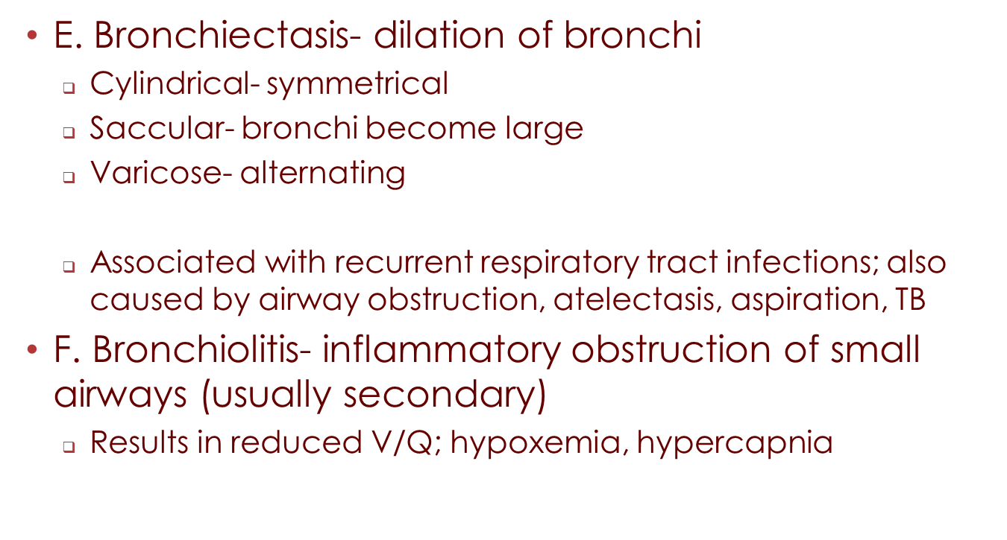

Slide 41
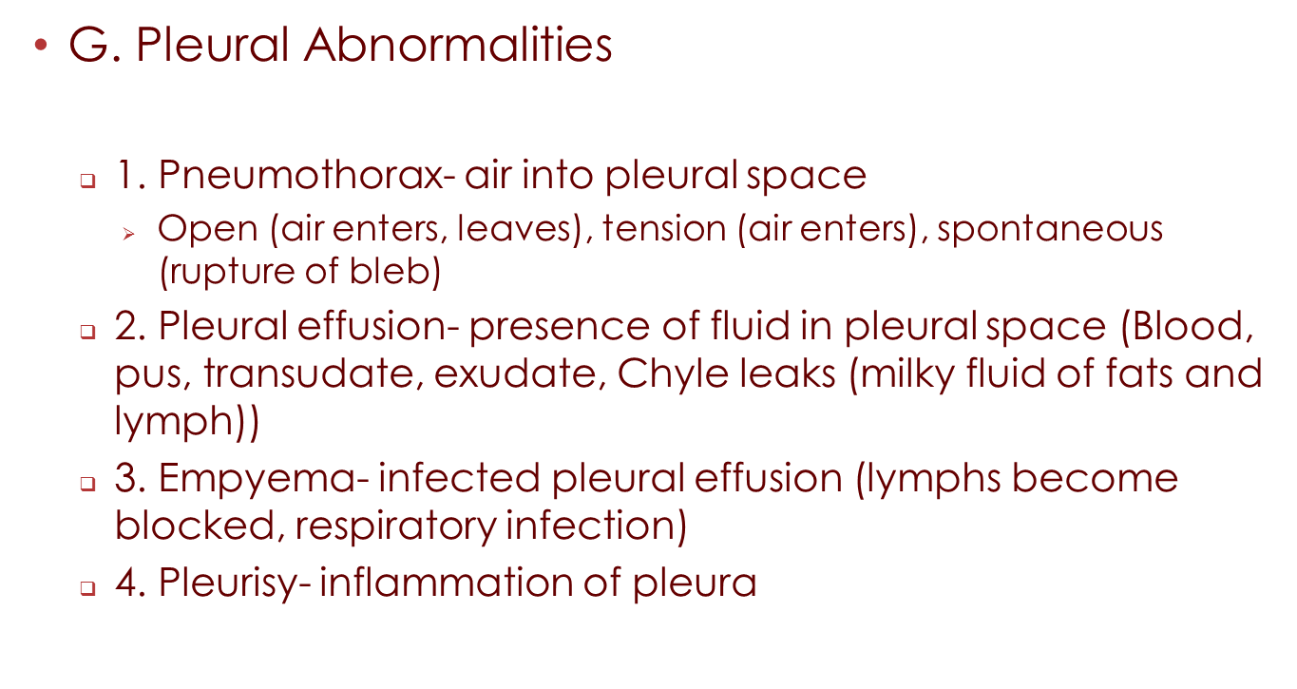

Slide 42
H. OBSTRUCTIVE DISEASES-LUMEN, AIRWAY WALL, LUNG PARENCHYMAL
1. Emphysema-chronic infection of bronchi, chronic obstruction, trapping of air
  Increased resistance, decreased capacity, increased work
2. Bronchitis-excessive mucus production, increased bronchial smooth muscle; inflammation or infection are causes
3. Asthma-genetics, environment are causes; spastic contraction of bronchiolar smooth muscle; bronchiolar muscles-parasympathetic creates constriction (acetylcholine); sympathetic-epinephrine-dilation

Slide 43
DIAGNOSING OBSTRUCTIVE/RESTRICTIVE CONDITIONS
Pulmonary function test
Maximal inhalation followed by blowing, as rapidly as possible, the air out
Ratio of FEV₁/FVC provides diagnostic determination
  Obstruction-ratio less than 0.8, restriction-ratio greater than 0.8

Slide 44
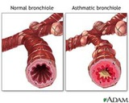
BRONCHOCONSTRICTION

Slide 45
I. INTERSTITIAL (OR RESTRICTIVE) DISEASES
Diseases that are characterized by conditions that produce stiff, non-compliant lungs
1. Parenchymal Disease- Diffuse Interstitial Fibrosis
2. Pleural Disease- Pneumothorax
3. Chest Wall Disease- Scoliosis
4. Neuromuscular- Polio, MS

Slide 46
J. VASCULAR DISEASES
1. Pulmonary Edema
2. Pulmonary Emboli
3. Pulmonary Hypertension
4. Cor Pulmonale- Right Heart Disease

Slide 47
K. Occupational Diseases- pneumoconiosis, glass, asbestos, coal, cigarette smoking
L. Infectious Diseases- Pneumonia, TB, AIDS
M. Suppurative Disease- disease of exocrine glands causes mucus plugging-cystic fibrosis (major cause of chronic respiratory disease in children)

